Slide 1
Aristotle
The great Greek philosopher
(Aka the best philosopher ever)

Slide 2
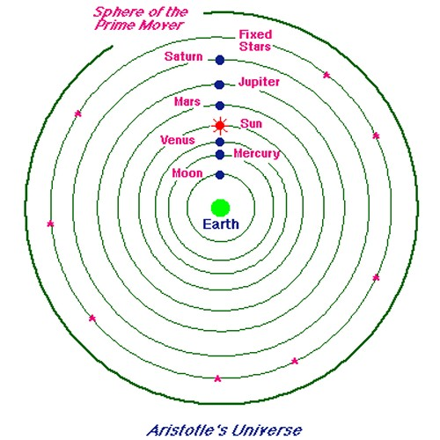
Contribution to the orbital motion theory
Believed that the planets and the Sun orbited Earth. He saw no sign that the Earth was in motion. This meant that the Earth had to be stationary, and the planets, the Sun, and the fixed dome of stars rotated around Earth.

Slide 3
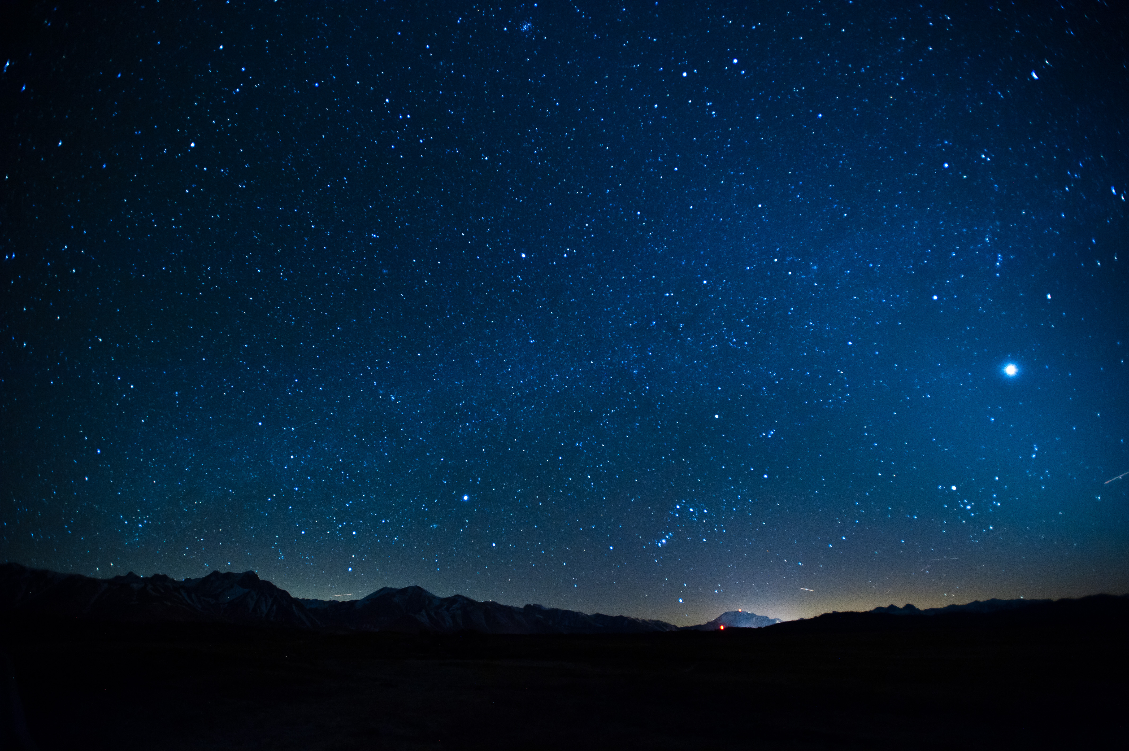
Reasonable criticism of the theory
in his time period how would he know any different? while on earth it is impossible to tell, and all you can see is the stars and sun moving across the sky day in and day out, so at the time his theory was sufficient. Now with all the technology we have, we now know he was wrong, but his theory was widely accepted for a long long time.

Slide 4
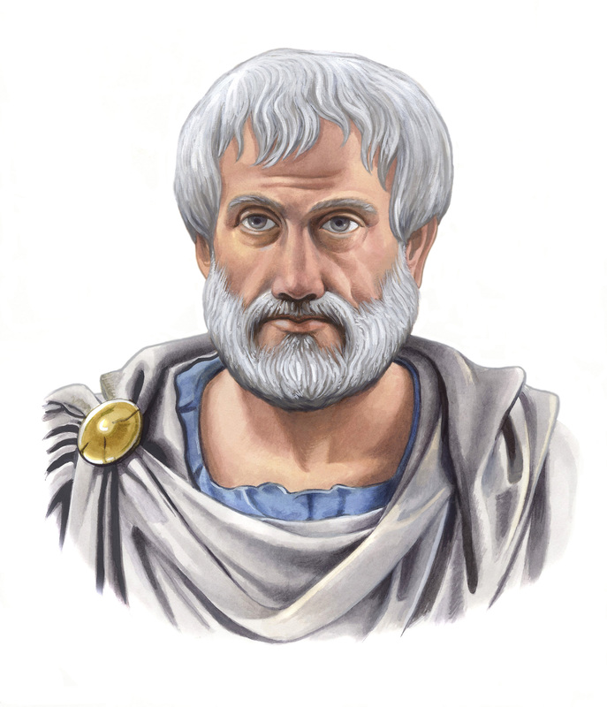
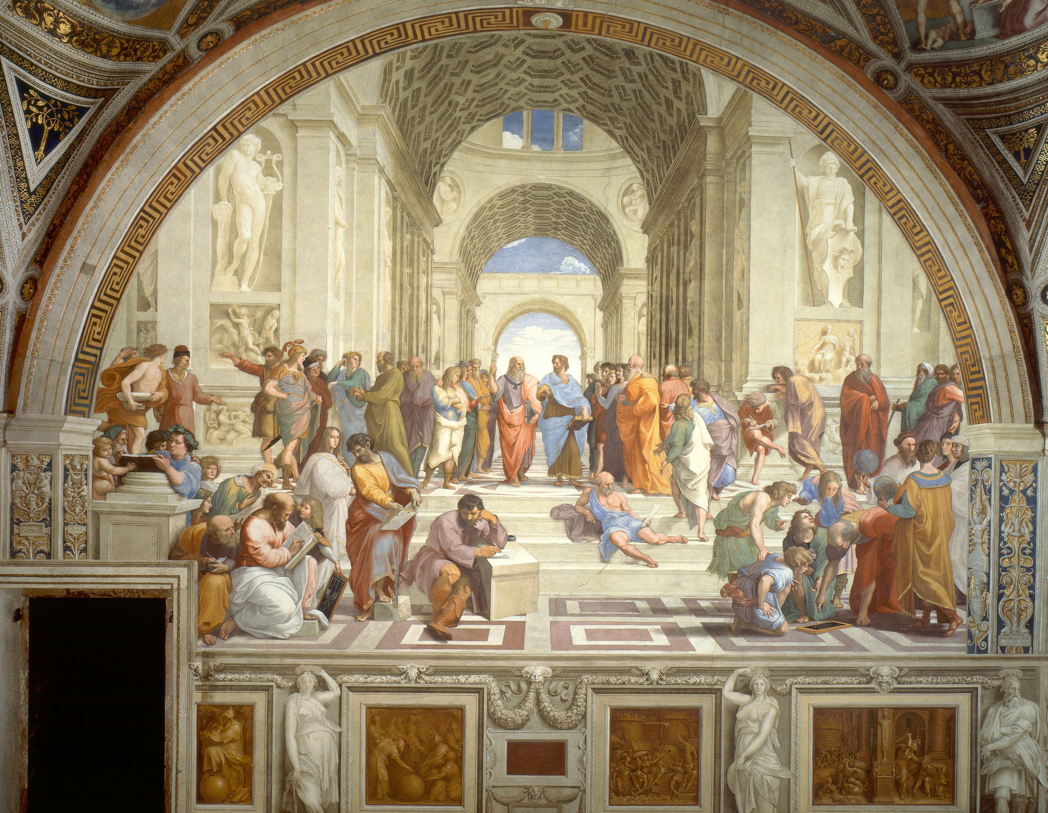
Life facts
Born: 384 BCE Education: Plato's academy Marriage: Married a woman named Pythias Children: Daughter Pythias and Son Nicomachus Death: 322 BCE

Slide 5
Conclusion questions
1. Explain why the study of orbital mechanics is so controversial 1a) It was controversial in the past because it was nearly impossible to tell what revolved around what since on earth we cannot tell that we are in constant motion, and everything in retrospect does seem to revolve around us. but with technology we now understand that we do in fact revolve around the sun. 2. What factors contribute to a theory gaining mass acceptance? 2a) The more scientific evidence you have the easier it is for people to believe you. 3. What impacts did each of the following contributors make on the evolution of orbital mechanics? a.Nicolaus Copernicus b.Tycho Brahe c.Johannes Kepler d.Robert Hooke e.Sir Isaac Newton 3a) In 1515 Nicolaus Copernicus proposed that the Earth was a planet like Venus or Saturn, and that all planets circled the Sun. 3b) Tycho Brahe: Brahe believed in a model of the Universe with the Sun orbiting the Earth but the other planets orbiting the Sun. 3c) Johannes Kepler: Made 3 Laws.The orbit of a planet is an ellipse with the Sun at one of the two focal points.
A line segment joining a planet and the Sun sweeps out equal areas during equal intervals of time.
The square of the orbital period of a planet is proportional to the cube of the semi-major axis of its orbit D. Robert Hooke: Planets motion is determined by compounding its tangential velocity with the change in radial velocity impressed by the gravitational attraction of the Sun.
3d) Robert Hooke: Planets motion is determined by compounding its tangential velocity with the change in radial velocity impressed by the gravitational attraction of the Sun. 3e) Sir Isaac Newton: realized that the force by which an apple falls from a tree to the ground is the same one that makes planets fall around the sun. Newton also concluded such a planetary orbit should be elliptical.

Slide 6
Sources
https://biographies.knoji.com/30-interesting-facts-about-aristotle-the-great-greek-philosopher/
http://www.history.com/topics/ancient-history/aristotle
http://www.ucmp.berkeley.edu/history/aristotle.htm
http://www.biography.com/people/aristotle-9

