Slide 1
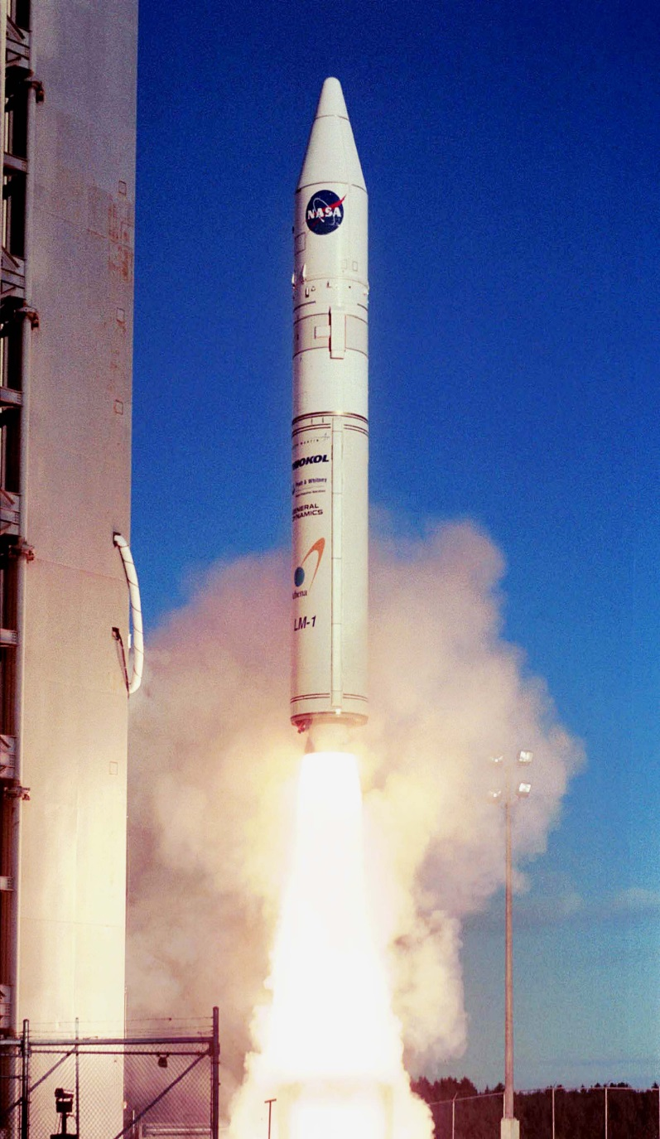
Space Propulsion
Reaction Wheel

Slide 2
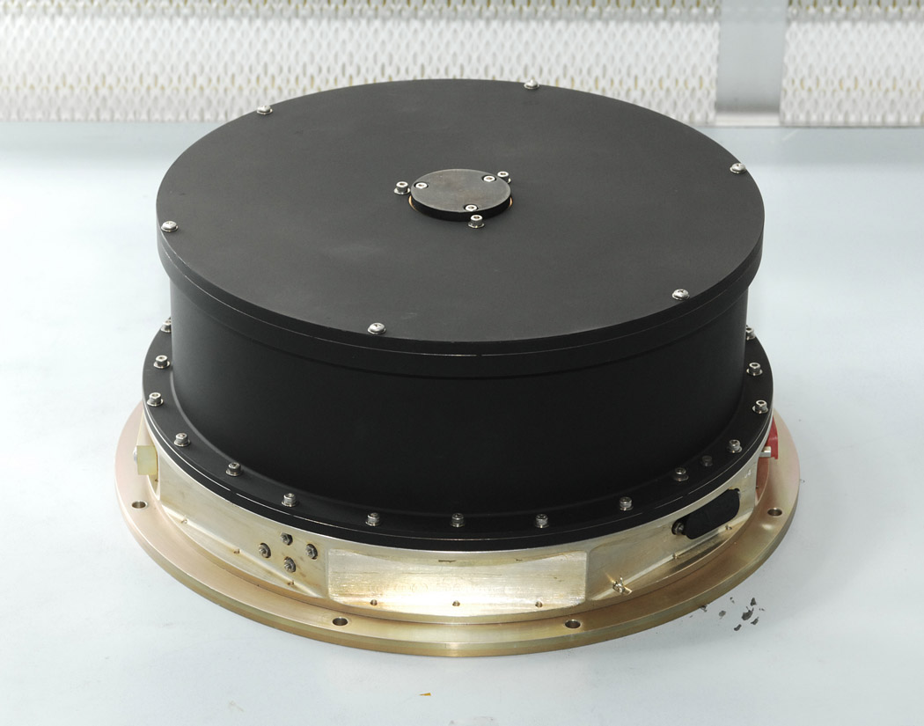
How it creates Propulsion
Reaction wheels actually do NOT create propulsion, they only create rotation.

Slide 3
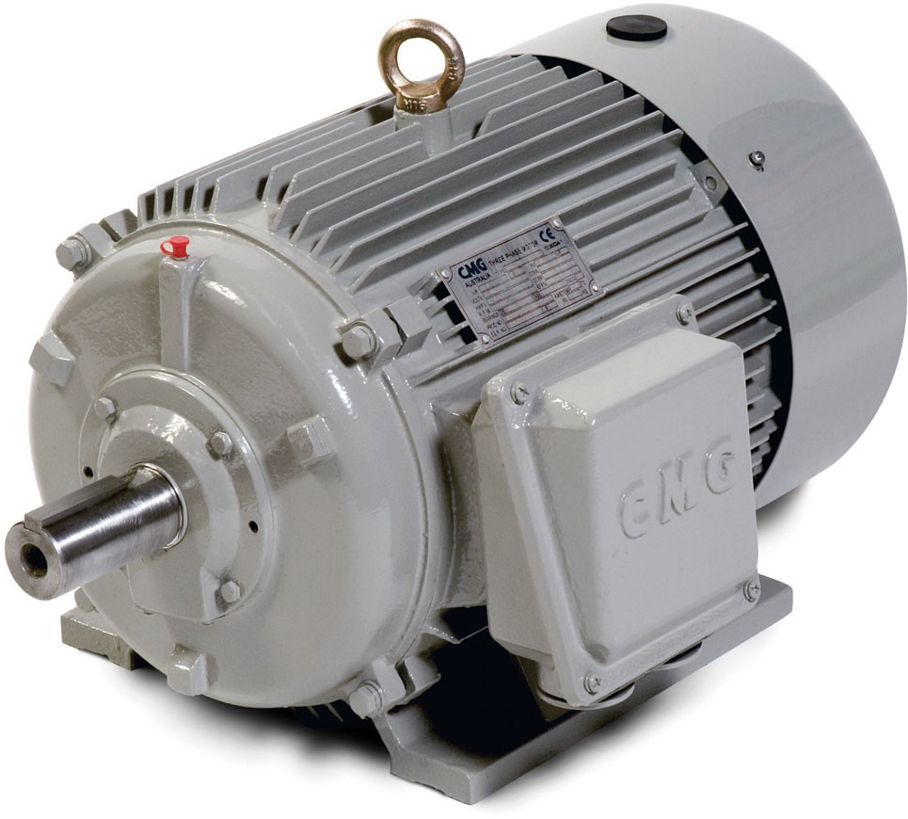
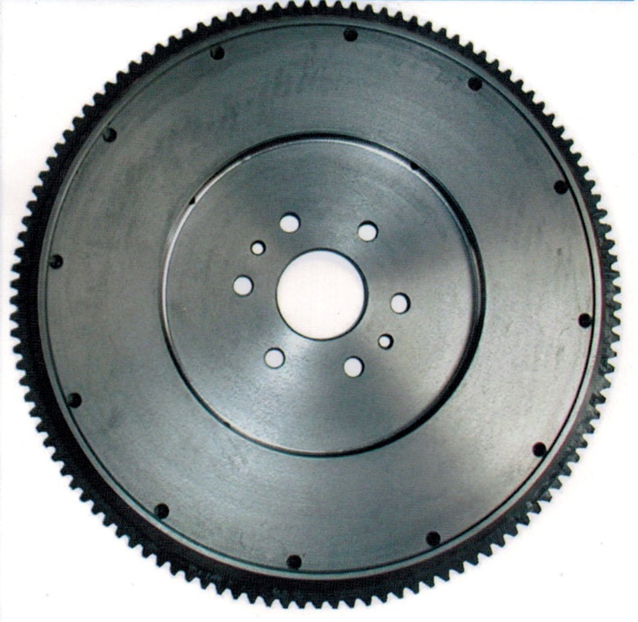
Main components of the system
Electric motor
Flywheel

Slide 4
When would it be most effective?
This would be most effective if precise rotations were needed, like when a space camera is trying to take a picture of a star or a planet at a distance, slight rotations help align them. Also boarding in space could have a need for them to make sure that they are fully aligned.

Slide 5
How the Energy is converted from fuel to propulsion
Does not use fuel or create propulsion.

Slide 6
How much fuel does this use to make altitude adjustments?
None, does not use fuel.

Slide 7
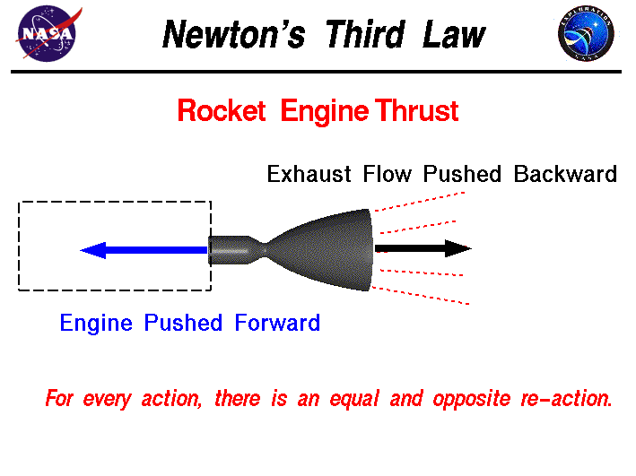
Conclusion Questions
Explain how the expansion of a fluid being propelled from the space vehicle is related to newton's laws.
- When the fluid is propelled out of the vehicle the reaction force pushes the vehicle in the opposite direction the fluid is travelling.
Explain how life span of the vehicle is dependent on the amount of fuel it has and how quickly it is used.
-Once the fuel runs out on a space vehicle the movement of the vehicle is very limited and the life of a vehicle is gone, however can be restored when more fuel is added however at the moment that is not cost efficient and using solar power to power the necessary functions has been the primary source of power to the vehicles once in space.

Slide 8
Sources
http://inventors.about.com/library/inventors/blrocketpriciples.htm
https://www.nasa.gov/
http://scienceworld.wolfram.com/physics/ReactionWheel.html

